Slide 1
Runnebaum Exclusion (Deannexation) and Annexation
Sept. 30, 2021 – Council Work Session

Slide 2
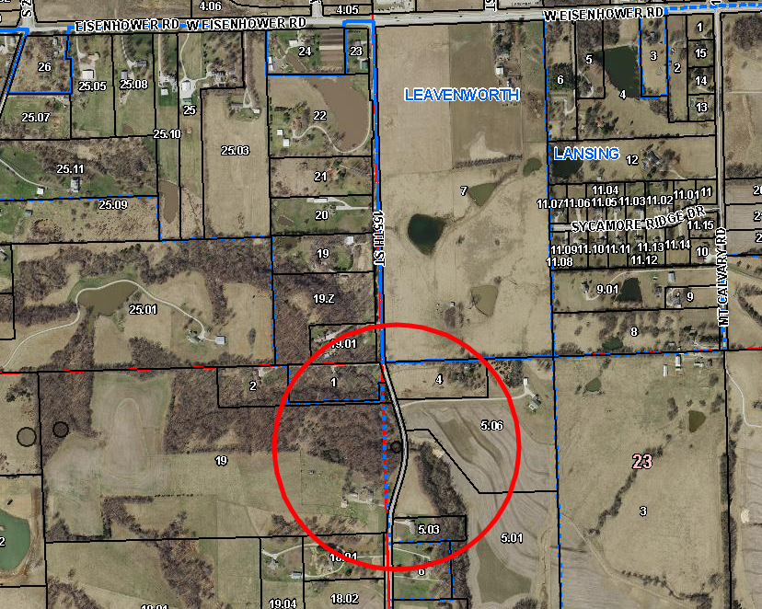
General Location
26629 W. 155th Street – approx. ½ mile south of Eisenhower and 155th Street intersection.

Slide 3
History
Annexation of this area resulted in the City Limit line following the section line rather than the property line in this area. This resulted in a split property in terms of jurisdictional authority.
A split property that is partially in the City and partially in the county is very difficult to plat or perform a lot split on since it would require both City and County to be signatories, review, etc.
Property owners have asked City Staff for assistance in how to move forward with cleaning this up so that they can develop two 2.5 acre lots, one in the county (where the existing house is) and one that would be annexed into Lansing (a new home build).

Slide 4
Items to Process
Establishment of West half of ROW for 155th Street
  Document signed by property owner and in-hand by City Staff ready to be recorded.
Exclusion of existing portion of the Runnebaum property
  What will be considered at the October 7th City Council Meeting
Splitting of the Runnebaum property
  To be completed and handled by Leavenworth County after exclusion of the portion of their property that is currently within the Lansing City Limits
Voluntary Annexation of a new 2.5-acre lot
  Documents have been provided to the City and signed by the property owner allowing for the voluntary annexation of this area after the split above is completed.
Ultimately – we exclude approx. 1.8 acres and will gain 2.5 acres through the exclusion / voluntary annexation process.

Slide 5
Exclusion / Annexation Map

Slide 6
Questions?

